Slide 1
Michael Plasmeier
Freshmen UROP Experience
Viral Communications
Notes:
Experience mixed

Slide 2
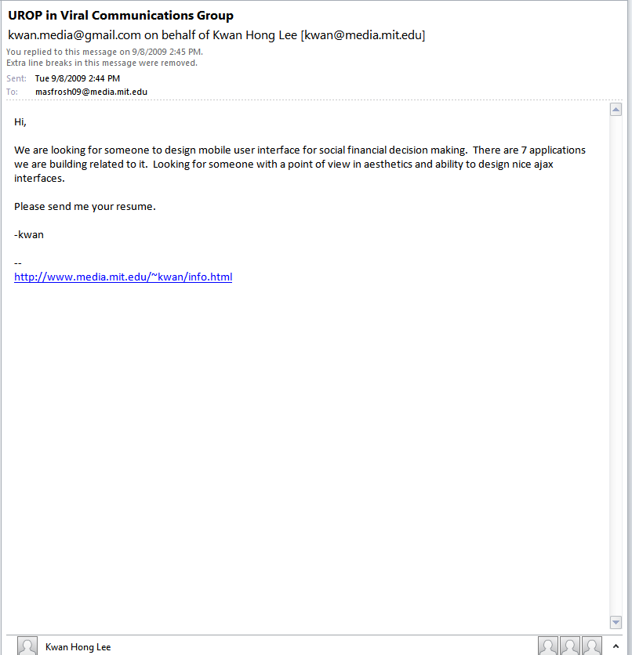
Notes:
Was the only canidate
Did not really want to do it sounded up my alley

Slide 3
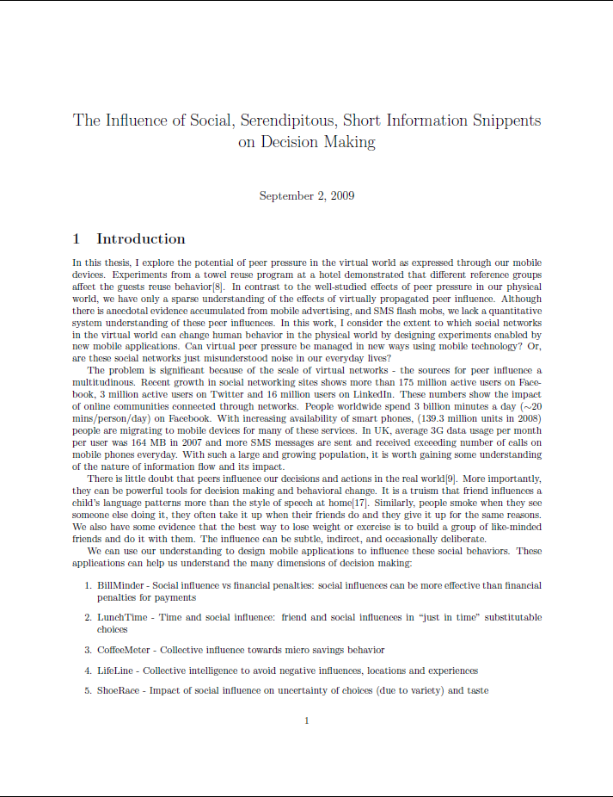

Slide 5
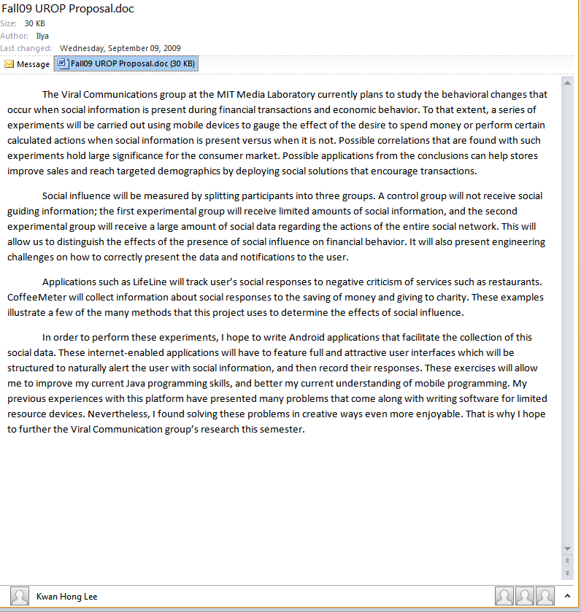

Slide 6
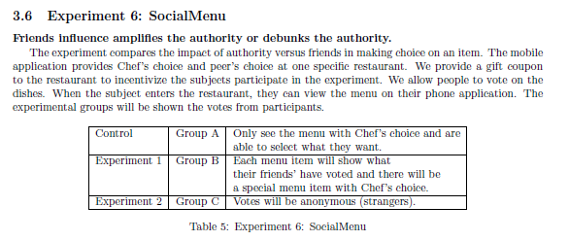

Slide 7
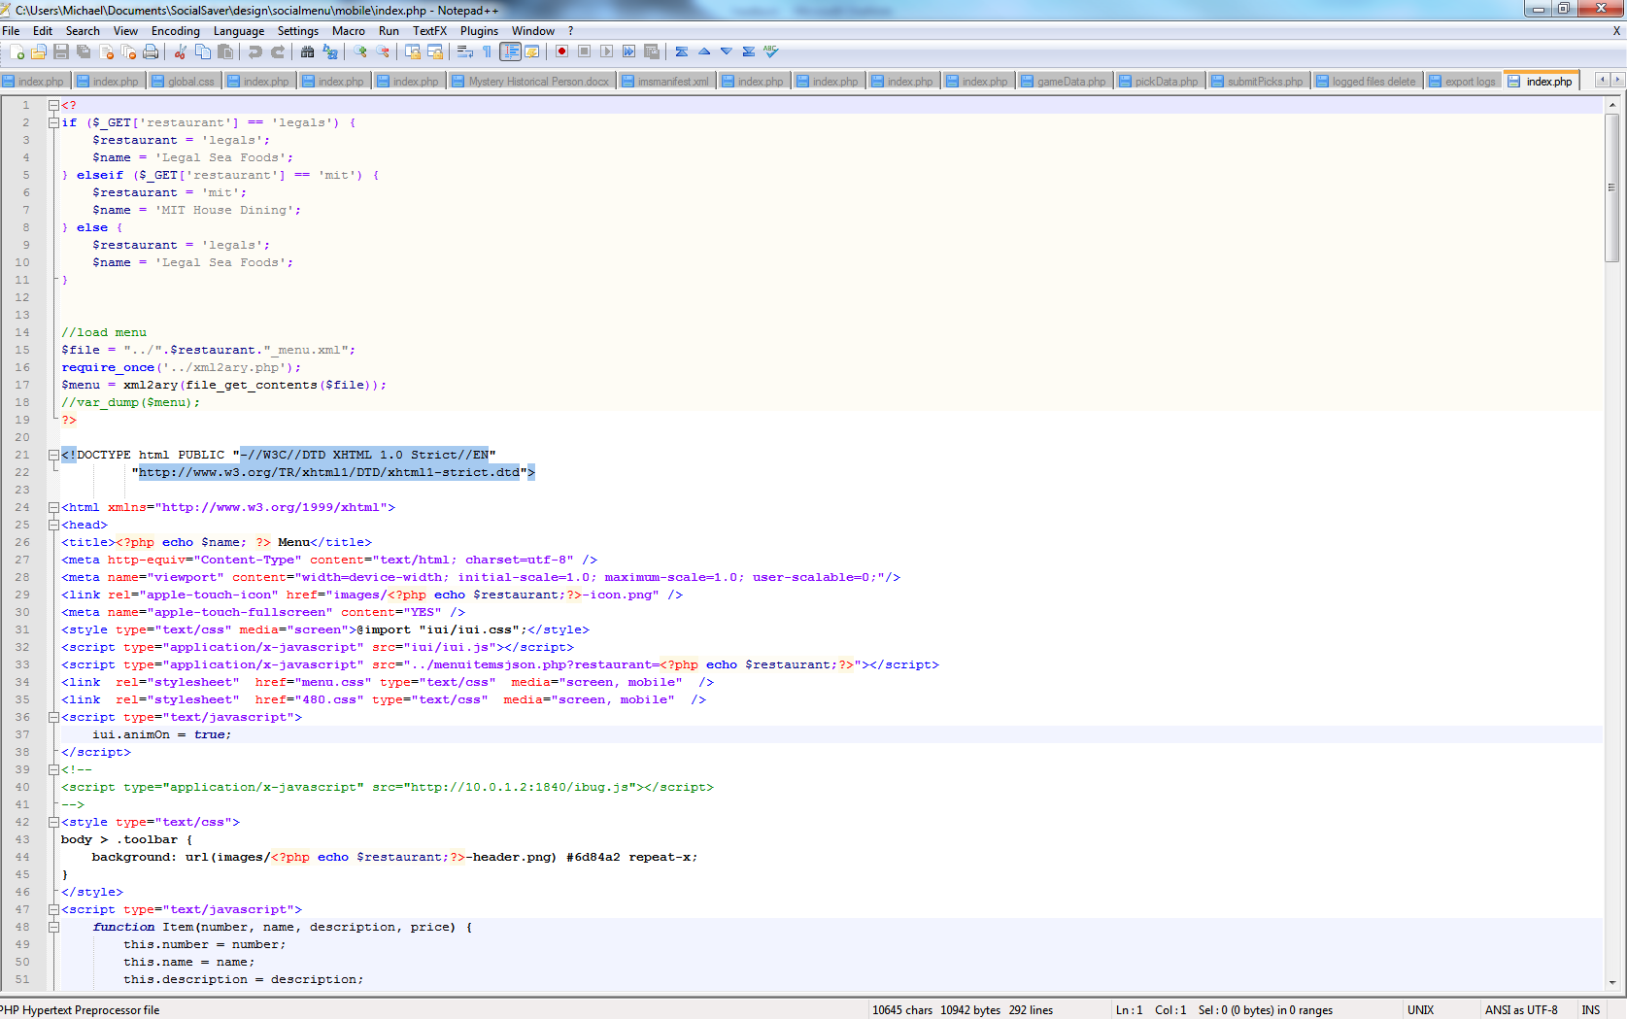
Notes:
Found was no good at coding
I did PHP – did not fit project
Learned a lot about different ways of coding here – 6.01 have not taken but sounds so different

Slide 8
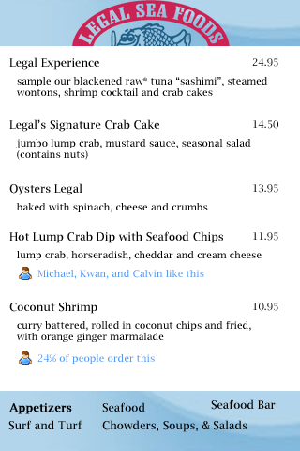

Slide 9
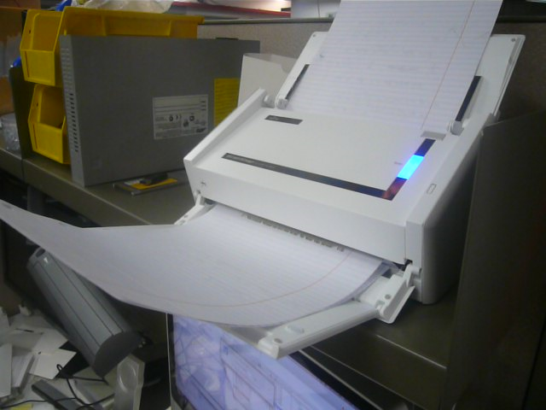
Notes:
Were going to be scattered around the lab

Slide 10
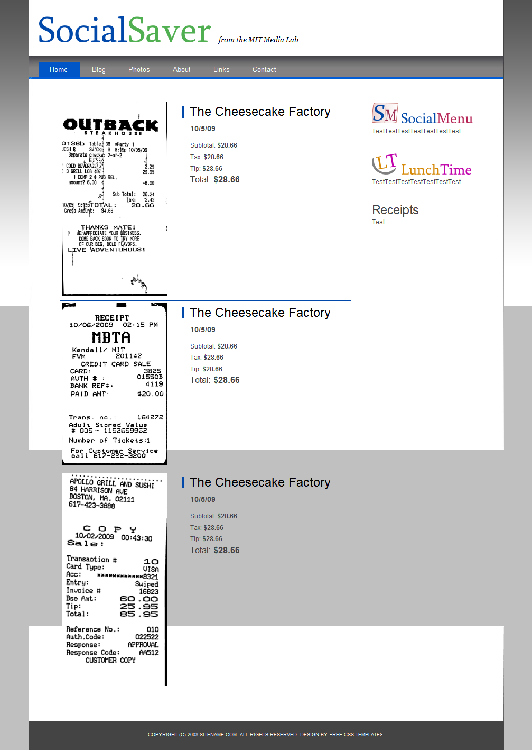
Notes:
Never finsihed at all
Decided not to do it to verify

Slide 11
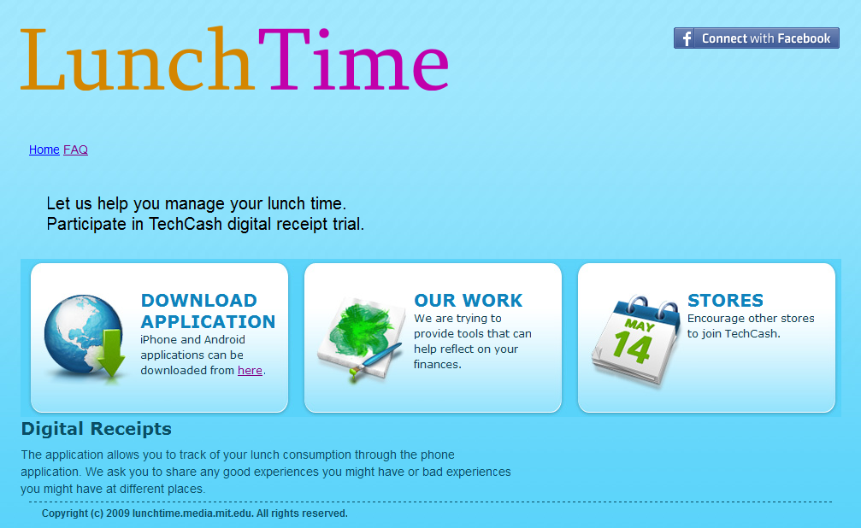
Notes:
Liked doing graphic design more
Kwan made this image – re!ally needed my help

Slide 12
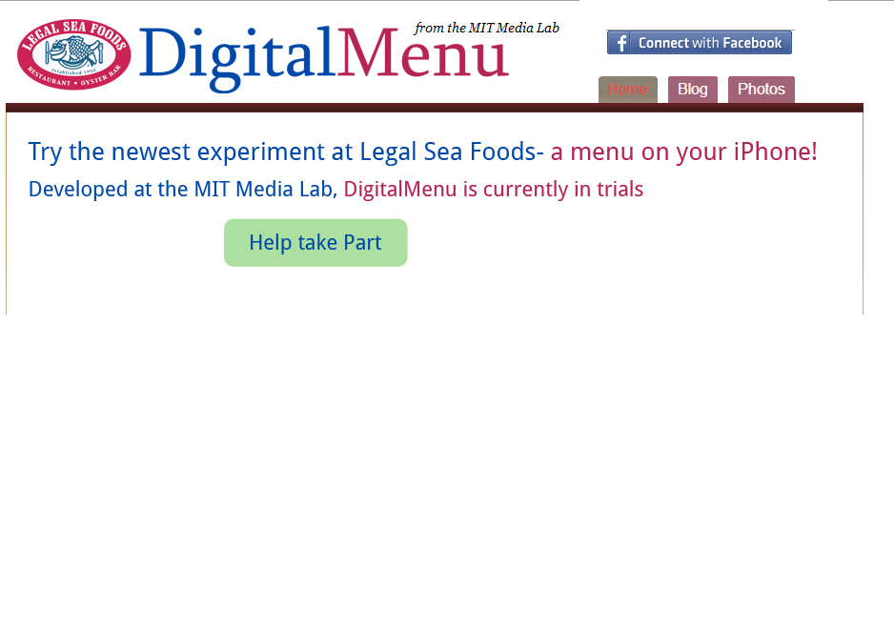
Notes:
First try in photoshop

Slide 13
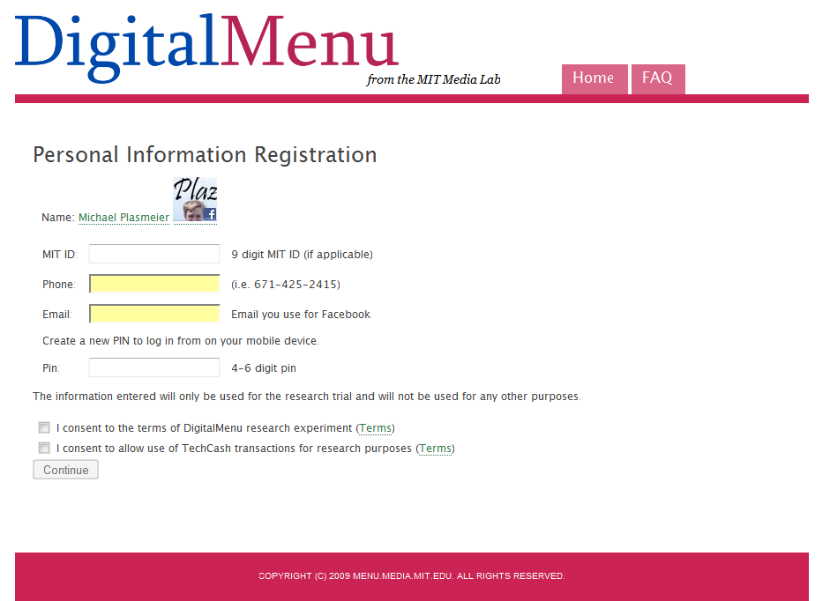
Notes:
Generic skin
Only color changes

Slide 16
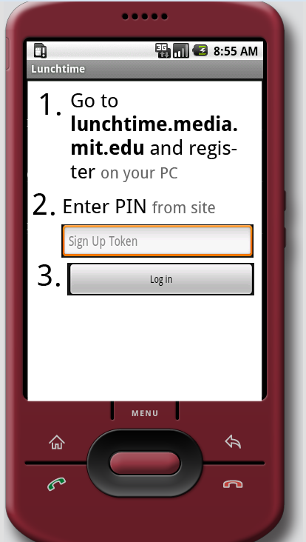
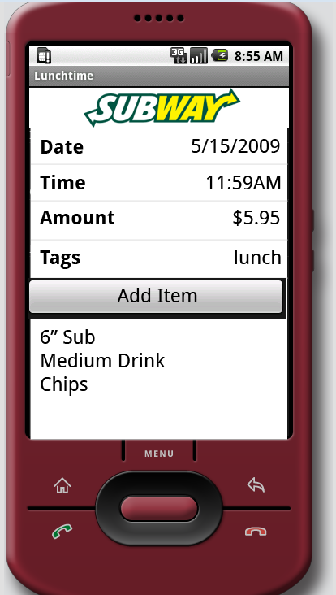
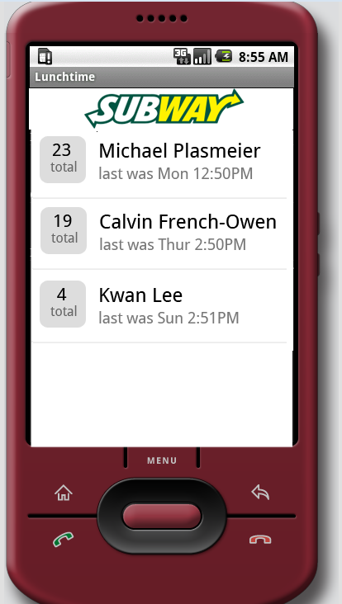
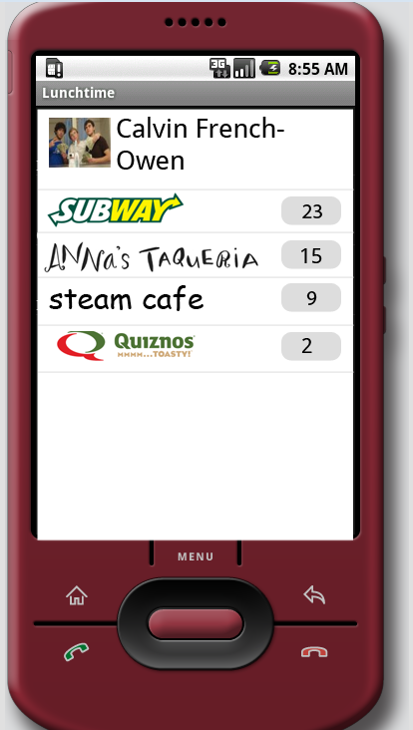
Android Mock-Ups
Notes:
Made some android mockups
Then android guy quit

Slide 17
Stores

Slide 18
MealTime

Slide 20
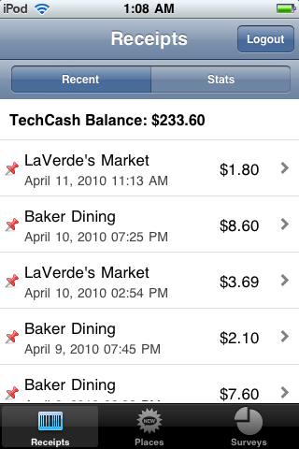
Notes:
This is live now
Can sign up me
Suppose to get friend recs, but not enough people

Slide 21
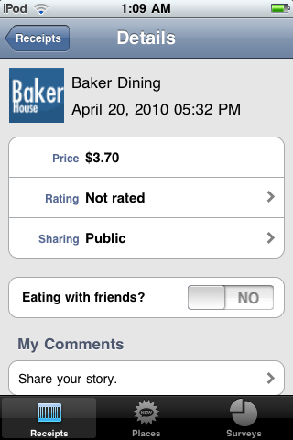
Notes:
First semester I would go where people rec’ed me
I ate at every place on campus
Now I just go on my routine

Slide 22
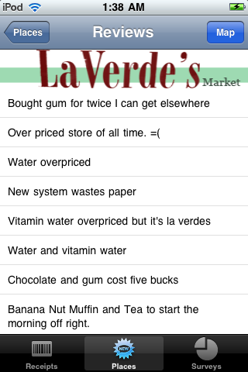

Slide 23
Notes:
More real time

Slide 24
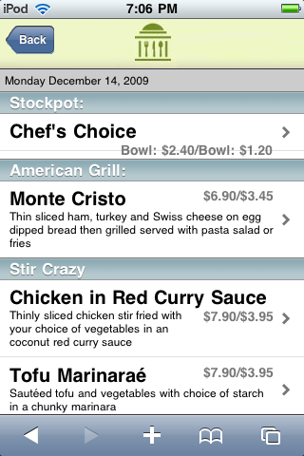
Notes:
Menu changes everyday
Data from cash register is hard
And data from their website
Never got off the ground

Slide 27
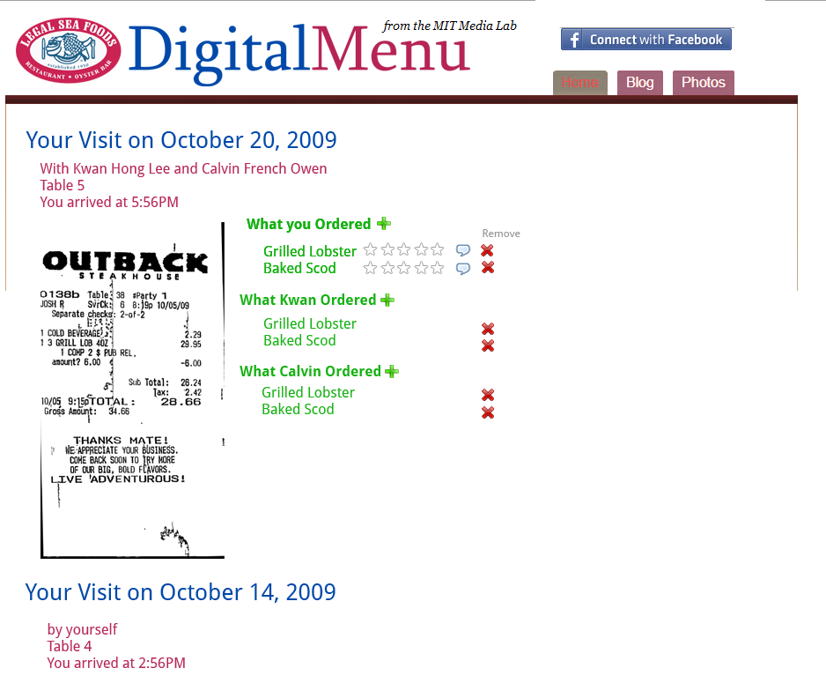
Notes:
Made more mock ups

Slide 28
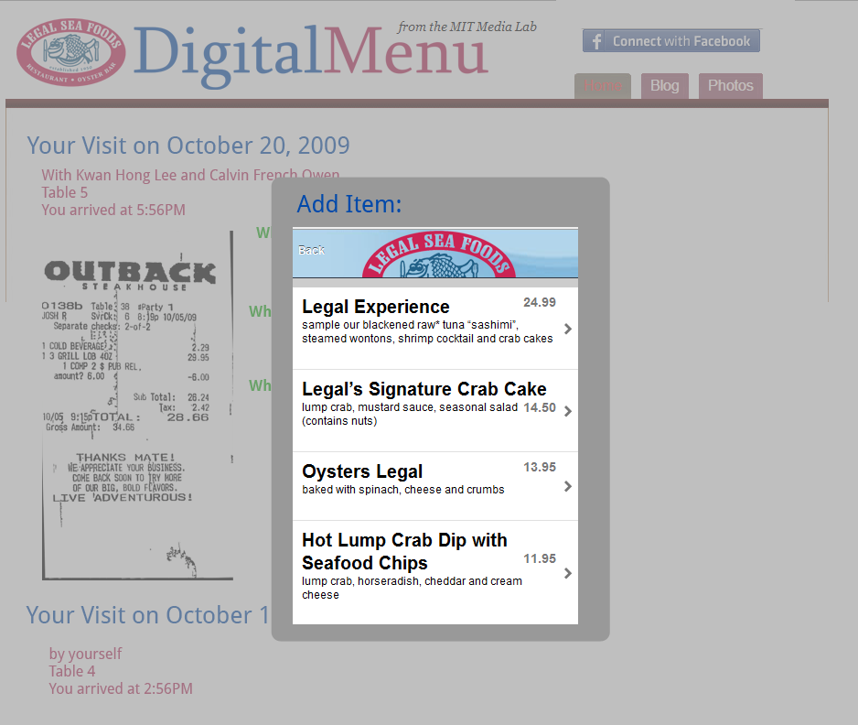

Slide 30
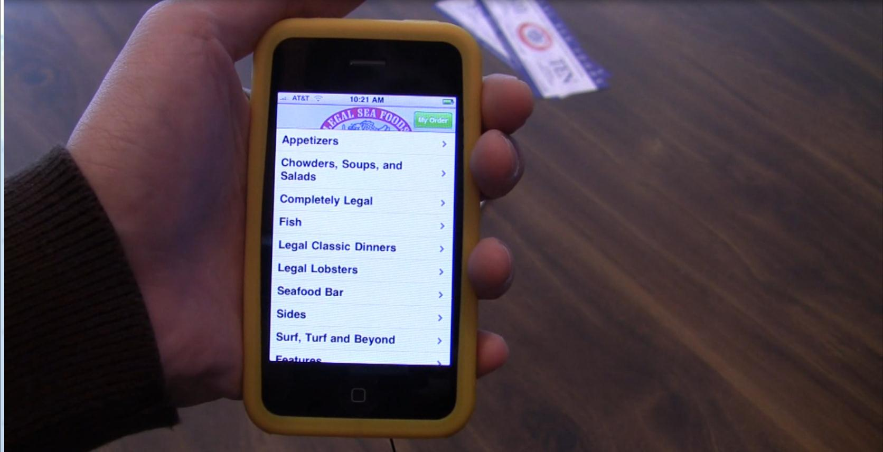

Slide 31
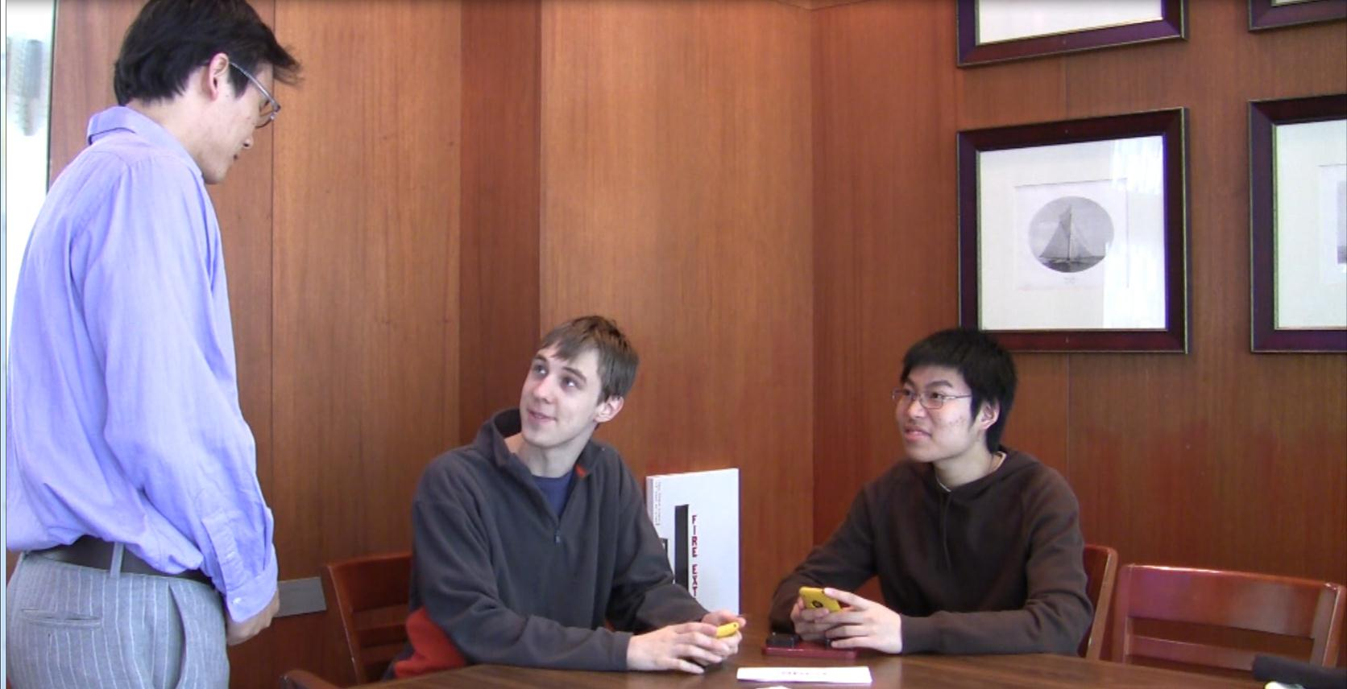

Slide 32
Notes:
Newest project
Not sure on status – kinda fell off as work got too busy!

Slide 33
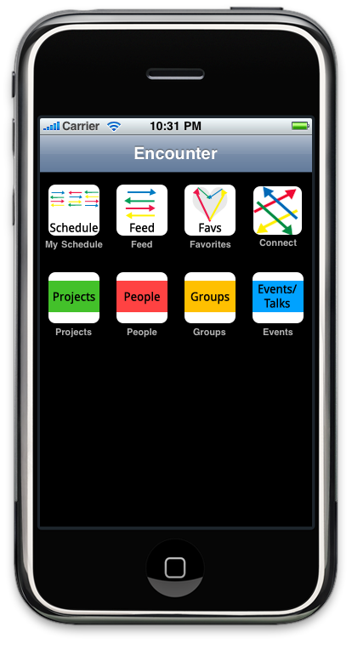

Slide 34
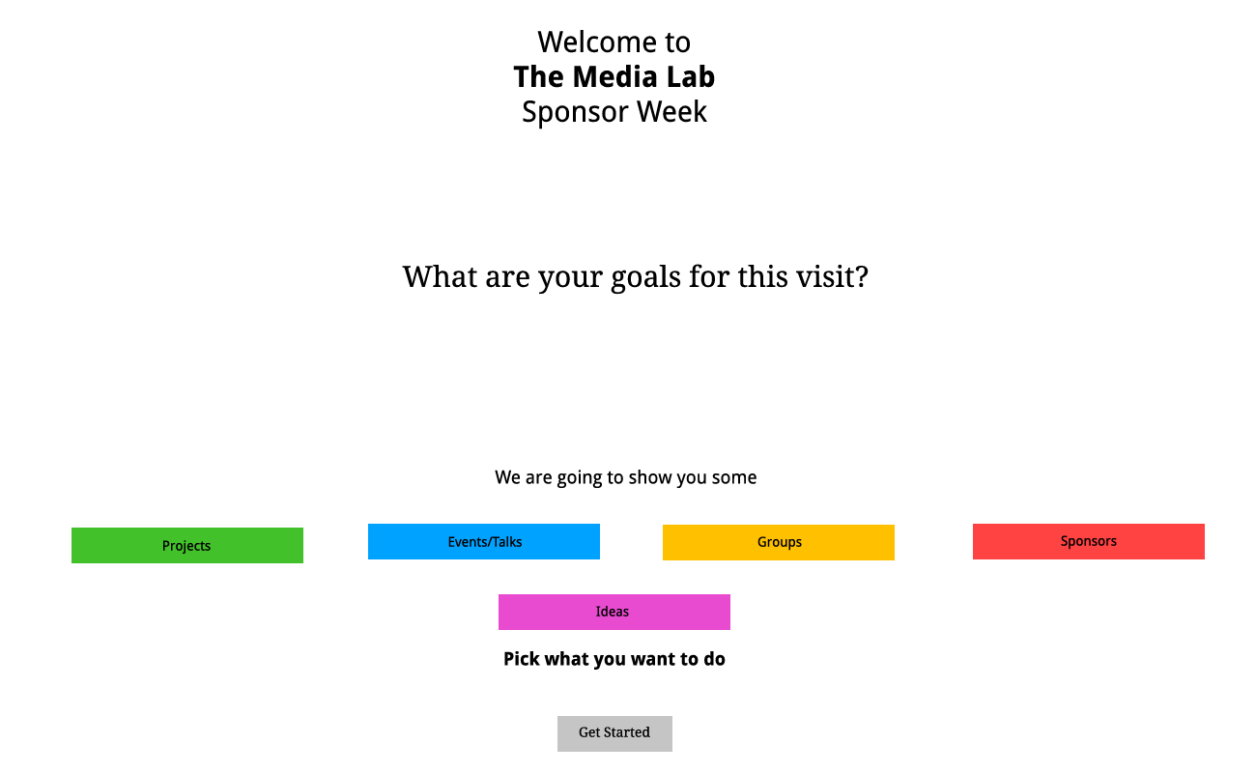

Slide 35
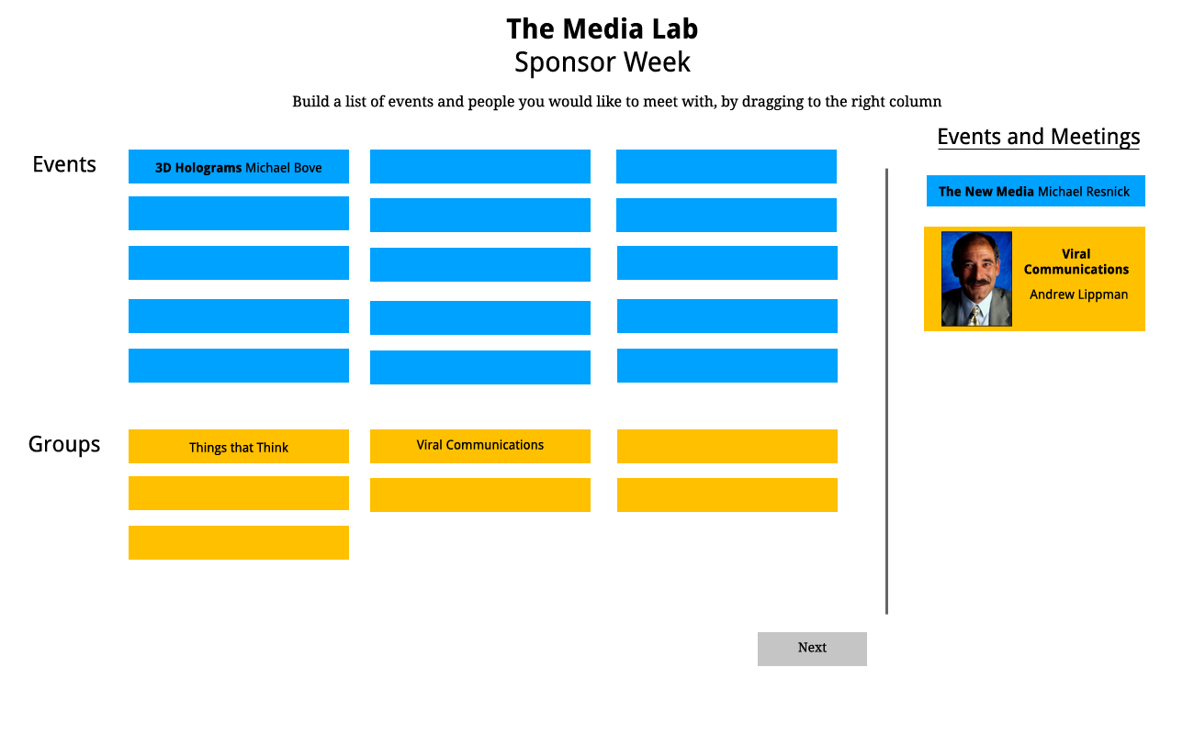

Slide 36
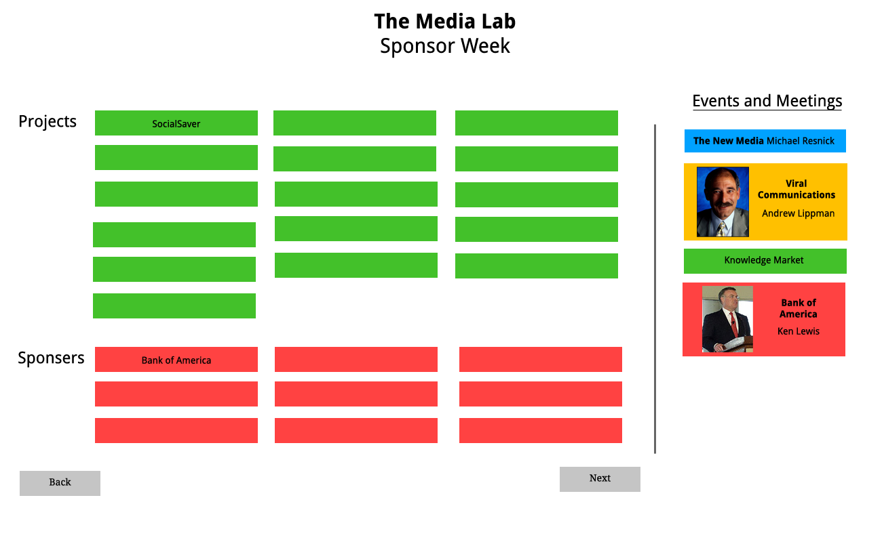

Slide 37
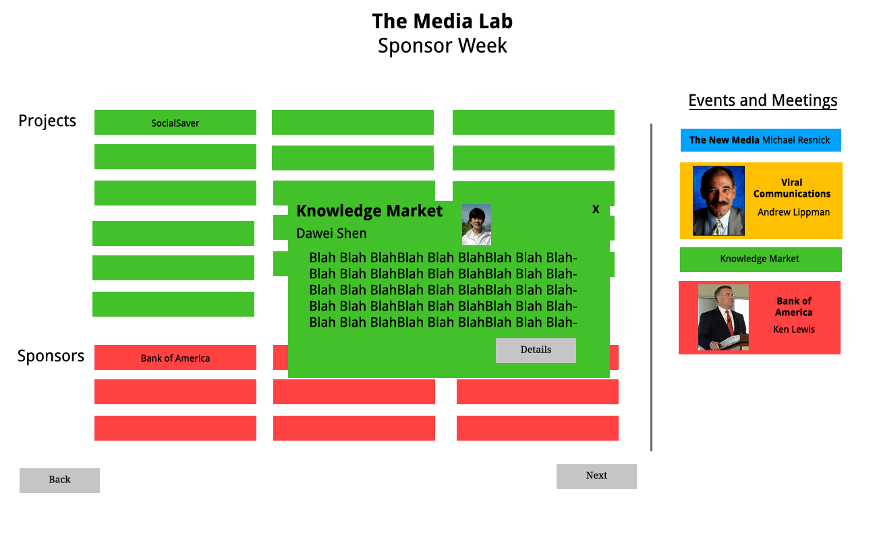

Slide 39
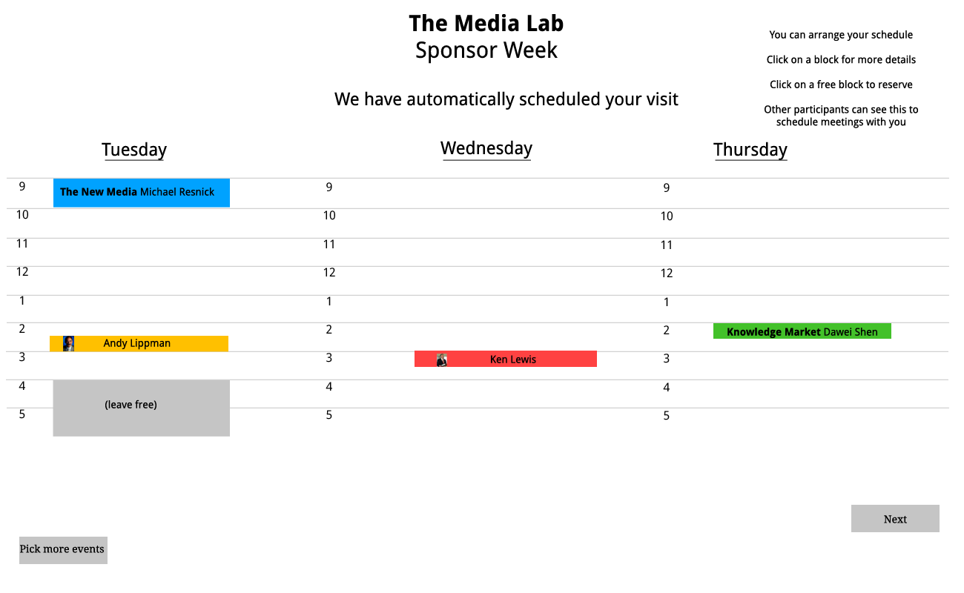
Notes:
Graphic skills got better

