Slide 1
Tooling and Printing in 2010: The Student's Perspective
Michael Plasmeier
Daniel Hawkins
Richard Dahan
For the UA
DRAFT 4/30/2010

Slide 2
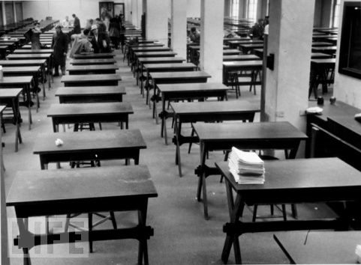
(Not yet official UA policy)

Slide 3
Printing
Spaces

Slide 4
Quota
2,000
Athena Printers
Dorm Printers
Copy Machines
CopyTech
Pages/semester
Double sided = 1 page
Notes:
Wide distribution
Some people print a lot
Most print a little
A number that would only affect perhaps 10% of undergrads
Usable at:

Slide 5
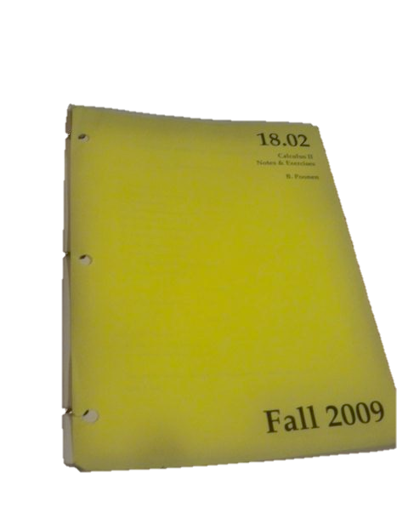
CopyTech
18.02 Course Guide
200 pages
Pay with quota pages
At a 30% discount
So 140 quota pages

Slide 6
Overage
$0.10
Per page
Notes:
Slightly higher than cost

Slide 7
Free
First 2,000 pages
Not having students worry about printing
$27/year currently
Moving there in dining
Simmons: 5x as much milk drunk when all you can eat
Not the place to incentive students to economize on
Notes:
Food different, but same point

Slide 8
Non-students
$$$
Pay
Charge em’

Slide 9
Hold and Release System
Implement one
At the printer touch screen
No preference as to vendor vs. home grown
Be careful of vendor lock in
Make sure authentication system works
RFID preferable

Slide 10
Locations and Equipment
Must buy new printers
And have a better plan to keep current
Keep/expand number of locations
Faster printers, so can reduce # of printers in one location
But keep spares in mind

Slide 11
Internal Model
Service
Price
Willing to pay (in total fees) a slight bit more for better service
But a Balance
Maintain free labor where possible
Dorms
Notes:
This is picking a servicing model

Slide 12
Internal Model
Not visible to students
Look at how costs would actually be saved – not just accept cost estimates
Where is the risk?
How often do we need new equipment?

Slide 13
Header Pages
With hold and release: kill

Slide 14
Drivers
Inconsistent
Fix!
And communicate changes better
Lots of comments

Slide 15
Double Sided
Students want to do it
Reduces weight and volume
Plus environmental
Inconsistent
Needs to be fixed, especially if quota
Best option: Ask on the release touchscreen, “Do you really want to print this single sided?”

Slide 16
Avoiding Paper
Electronic submissions system
Digital readings
Not ready yet
Don’t do just to save paper
Run trials

Slide 17
Kindle Trial at Princeton
Not successful
Good for readings
Saved 50% paper
Hard to annotate and find readings fast in discussion
http://www.dailyprincetonian.com/2010/02/22/25262/

Slide 18
Printing
Spaces

Slide 19
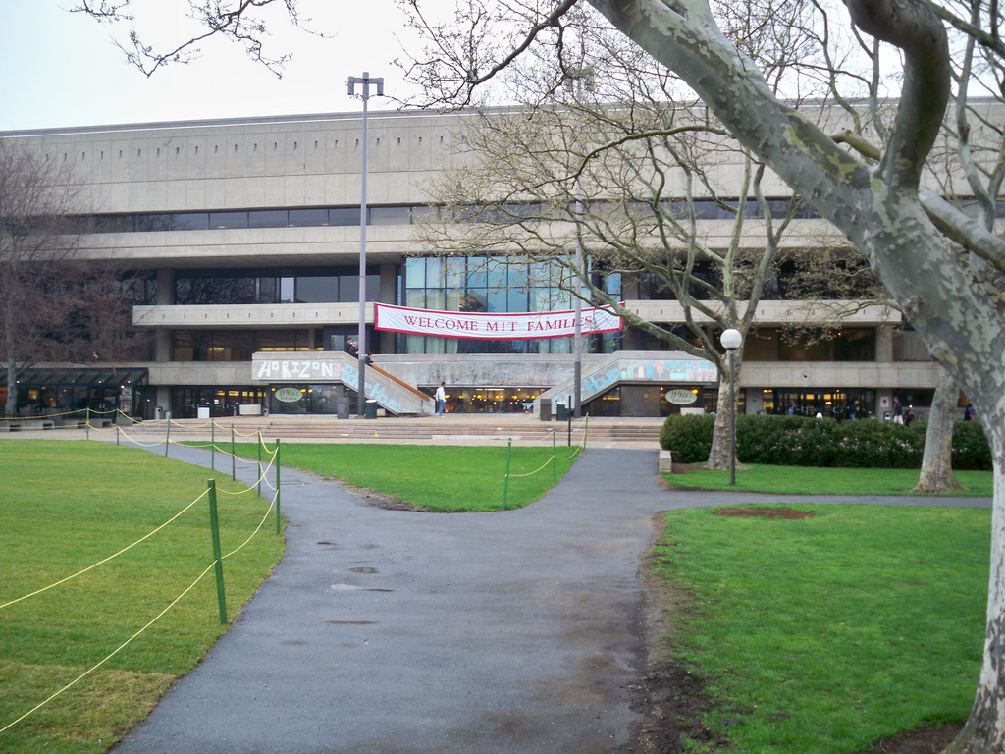
W20
Very popular
Group study rooms always filled
Students see as one space
Individual desk
Group
Computer work stations

Slide 20
The Plan
Extend this model across campus
Consolidate clusters
Reuse existing space

Slide 21
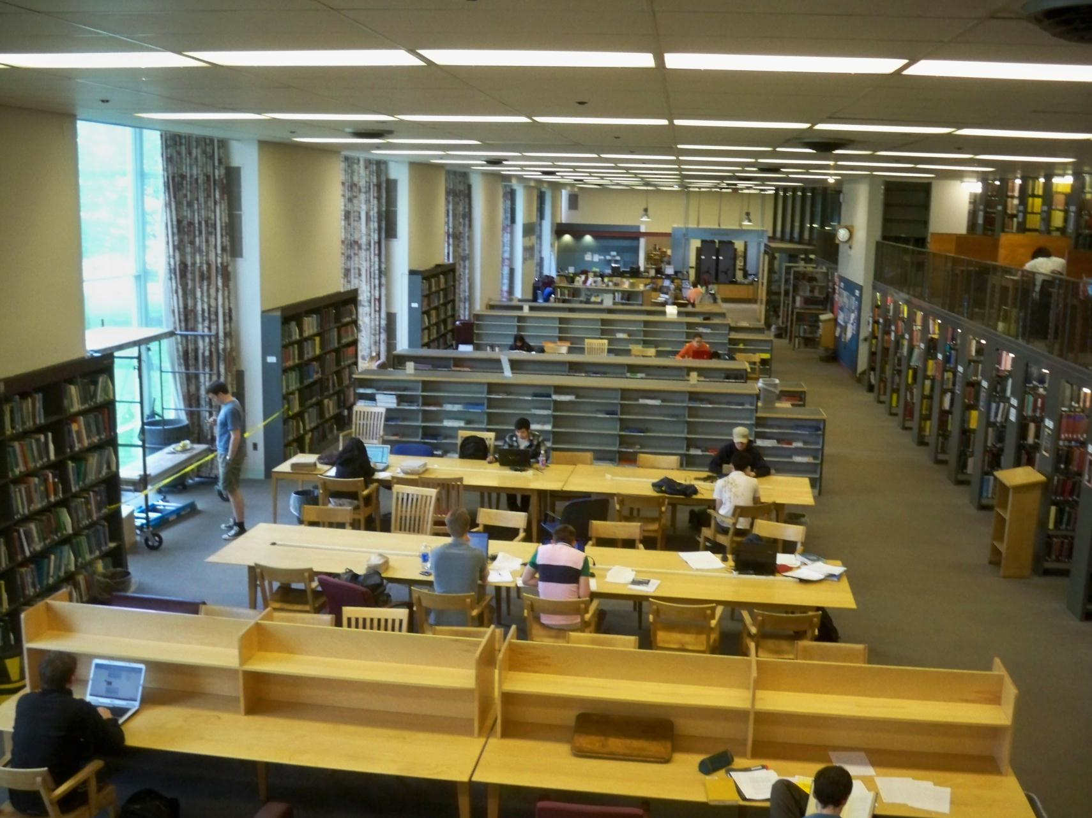
Hayden
Open and airy
But only open till midnight

Slide 22
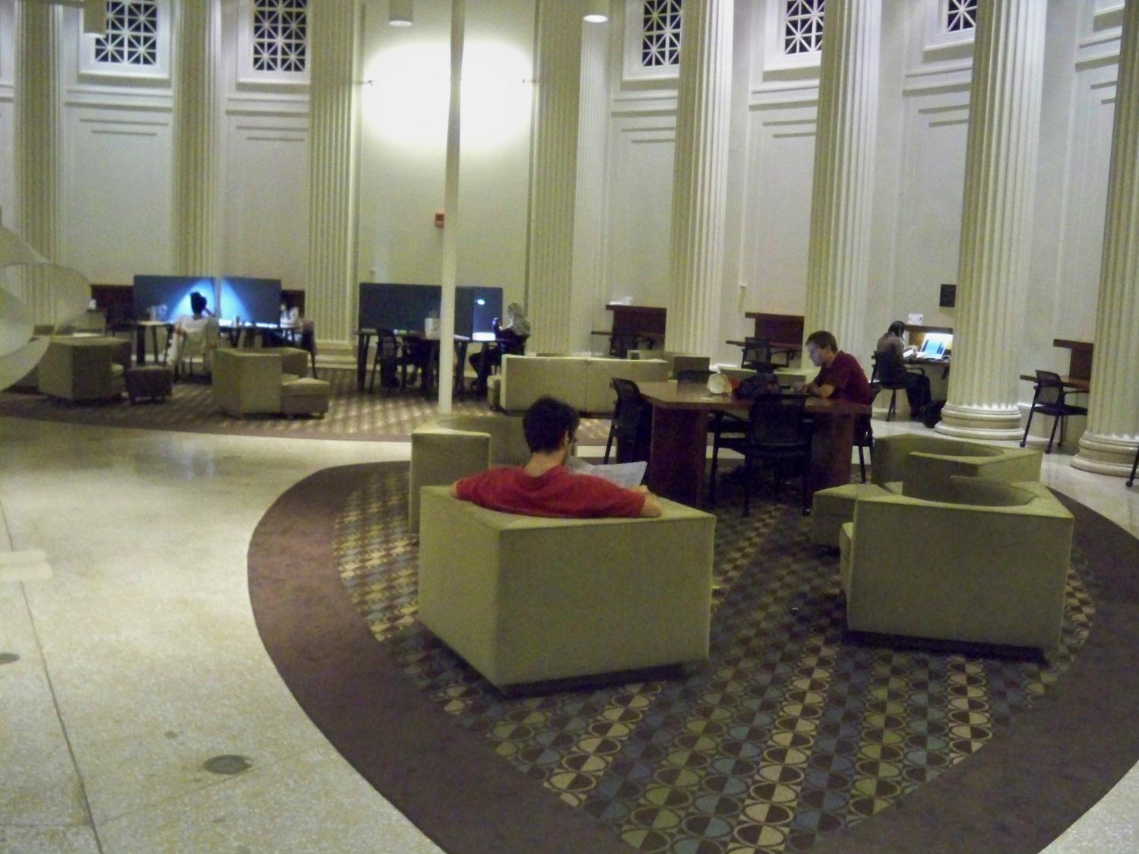
Barker
Iconic Space
Quiet nooks
Open to 11

Slide 23
Make Barker and Hayden open 24/7

Slide 24
Barker 5th floor
Hayden 1st floor

Slide 25
Remove
Secure desk
Very easy in Baker (move to 6th floor)
Harder in Hayden
Remove books
Easy in Barker (3 shelves)
Difficult in Hayden

Slide 26
Replace with
About 50% more computer workstations in both
Add group study rooms to Hayden

Slide 27
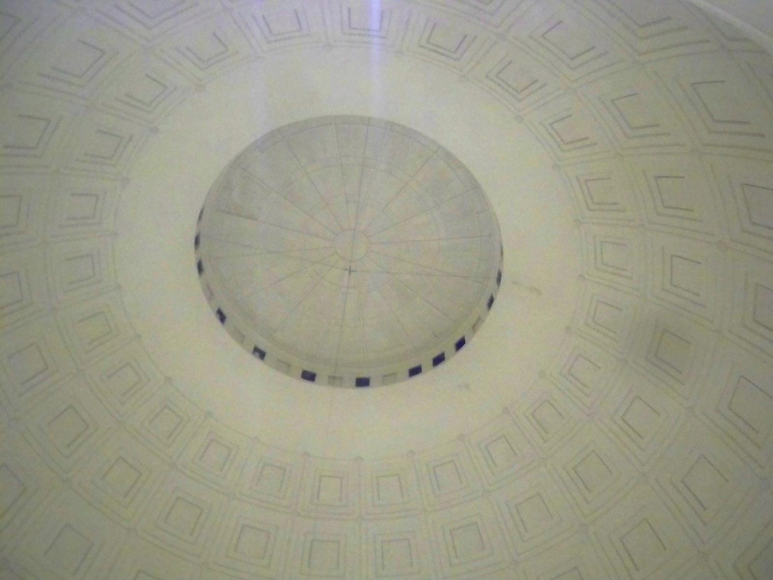
Barker
Easy to change
Move desk to 6th
Move journals to 6th
Move Athena cluster down to 5th
Keep 4th offices and bathrooms
Secure stairs and elevator after hours
8th floor?

Slide 28
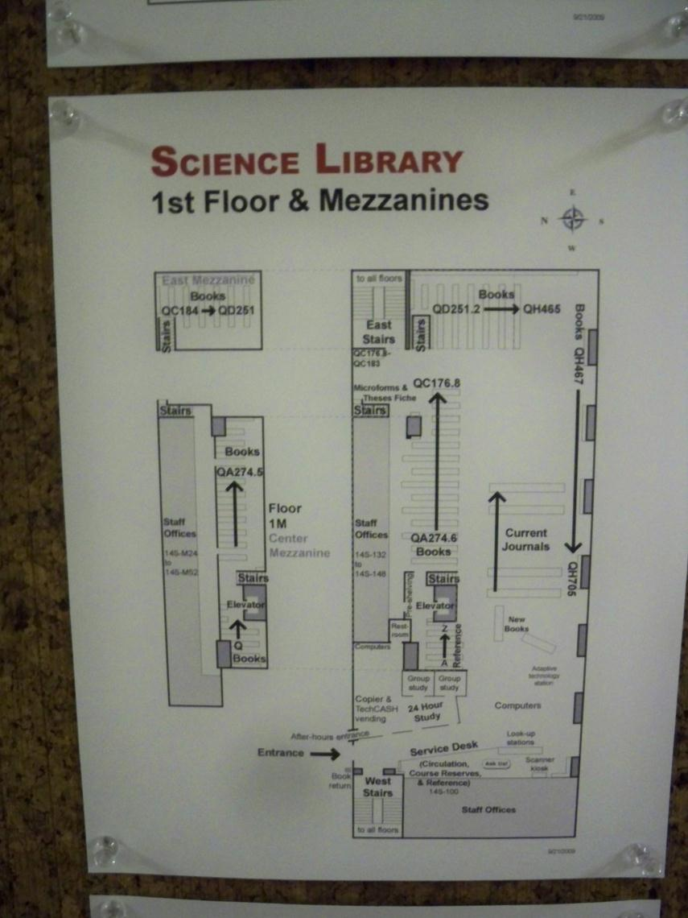
Hayden
Desks
Same #
Computers
Expanded 50%
Group Study Rooms
Plan A
Group Study Rooms
Plan B
Unsure
?Books caged off
Other uses
Desk
Caged off

Slide 29
Group Study Rooms
Plan A
Move books
Construct study rooms
Could build ~7 group study rooms
Book relocation?
Plan B
Reassign offices
14N-132, 134, 136, 144, 148, M52, M48, M44, M40, M36
10 ready made group study rooms
No construction
Plan A and B
17 group study rooms

Slide 30
Other Cluster
38-370 Close
37-312 Windows Classroom Keep open 5-9
37-332 Close
37-318 Keep Open? While class in session
1-115 Classroom Reopen 5-9 (like 37-312)
4-167 Sun Close
2-225 Close
2-032 Close

Slide 31
More Clusters
12-182 Keep Open Infinite Corridor
56-129 Keep Open Infinite Corridor
66-080 Keep Open Ultra Quiet and New Technology
E51-075 Sloan Keep Open

Slide 32
New Quickstaions
All with printers
34 lobby
Stata center (printer)
New buildings? 76, E14, E62
E25 lobby
TBD
5 total new quickstations
Location most important thing in UA survey

Slide 33
Timeframe
Fall 2010
Barker Renovations
5-10 Quickstations with Printers Installed
New Hold and Release (if Pharos) and Printers
4-167, 38-370 and 37-332 Close
Fall 2011
Hayden Renovations
W20, 66 Renovated
2-225, 2-032 Close
12, 56, E51 Furniture Refreshed

Slide 34
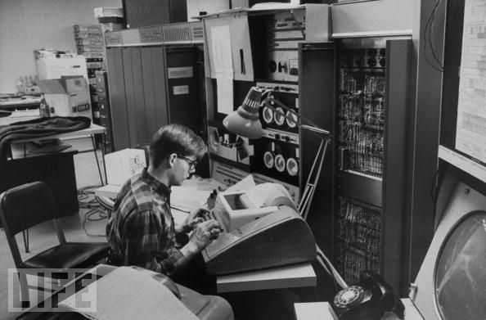
24/7 and Security
24/7 very important part of MIT culture
Only time machines were available
Works with Athena today
All equipment will be continued to be locked down
Can work this out

Slide 35
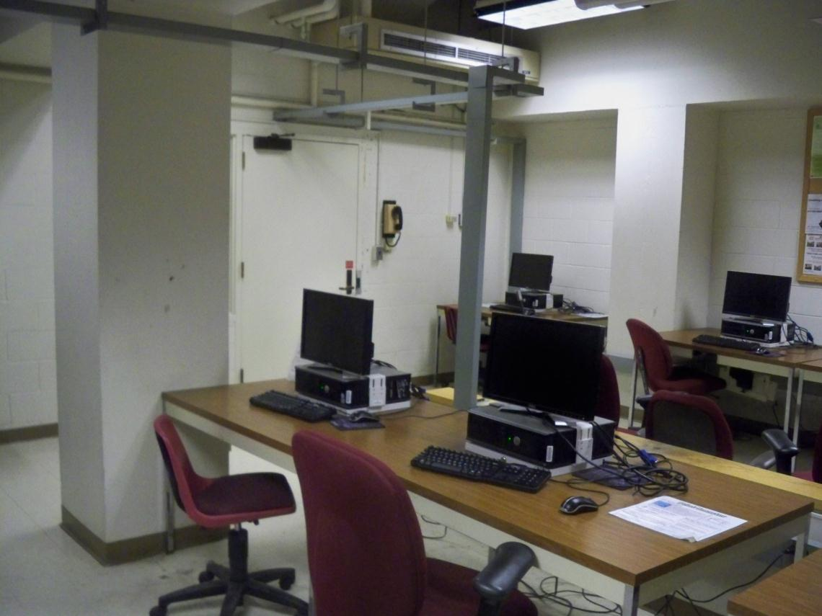
Libraries do a great job of maintaining space
IS&T does not
Give Athena Spaces to the Libraries
IS&T Keep Hardware and Software

Slide 36
Not just computer labs
Information centers
21st Century

Slide 37
Athena Spaces
Long Work
Consolidated in one space
Desks
Group
Computers
W20, Barker, Hayden
Short Work
Location
Email
Printing
12, 56
5 new Quickstations
66 – Ultra quiet work and new technology
37-318 North group
E51 - Sloan

Slide 38
Department Spaces
SA+P rooms great
Classes and Staff 9-5
Student use 5-9
Attempt to get departments to share
Problem largely political

Slide 39
Little Things
RFID readers, not swiping, not code
Make some group rooms reservable
Easy to use website
Install plenty of power plugs with new construction and renovations
Group study rooms = actual rooms
NOT partitions
Don’t put in new tech because it seems cool
Smart Boards

Slide 40
We feel:
Fair and balanced plan
Give and get
Saves institute money by using existing space more effectively
Addresses everyone’s need
Or as close as you can get
*When implemented together

