Slide 1
Cooking Classes @ MIT
Idea Proposal and Evaluation
Group Report
15.279 Final Project
Spring 2011
Prof. Terence Heagney
Cathy Cao
Diandra Drago
Neel Hajare
Michael Plasmeier
Amy Zhang

Slide 2
Background
Goal of eating nutritious
Meal plan good in dining dorms; while at MIT
Some existing programs
Can set up dedicated facility
Glass Lab, Edgerton shop
But big investment up front
So pilot program

Slide 3
Student Interest Survey
Sent to various MIT email list
246 respondents

Slide 4
Would you be interested in a cooking class?
Notes:
# on slides

Slide 5
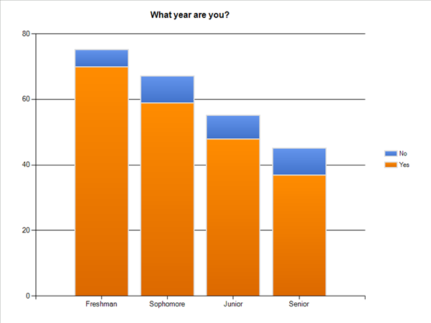
Interest by Year

Slide 6
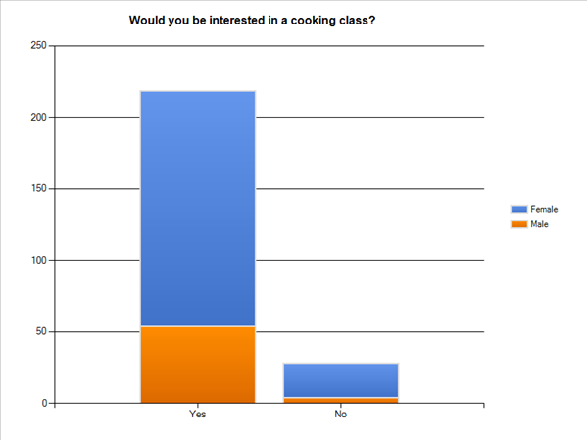
Interest by Gender

Slide 7
Staffing
Option | Pro | Con | Cost
Professional Instructors | Part time Current system with PE | High cost | $2,400 /course
Campus Chef Volunteers | Zero cost Easy access | Long-Term Dependability | 0
Student Volunteers | Low cost | Fickle Turnover | 0
Chefs from Local Restaurants | Student nomination Restaurants: publicity | Restaurant: time + cost | $?

Slide 8
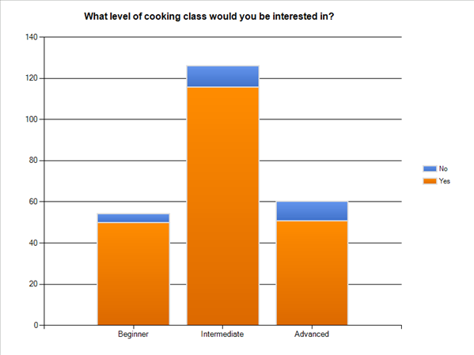
Level of Class

Slide 9
Staffing
Option | Pro | Con | Cost
Professional Instructors | Part time Current system with PE | High cost | $2,400 /course
Campus Staff Volunteers | Zero cost Easy access | Long-Term Dependability | 0
Student Volunteers | Low cost | Fickle Turnover | 0
Chefs from Local Restaurants | Student nomination Restaurants: publicity | Cost Uncertainty | $?

Slide 10
Curriculum

Slide 11
Curriculum
Culinary Arts
Beginner: Simple Dishes Intermediate: requested dishes + cuisine Advanced: professional training
Food Safety
Product Identification Food Handling Equipment Serve Safety
Notes:
Richard Berlin

Slide 12
Duration
Long term: semester long
Short term: few weeks
One time: few hours
Need 6 classes to fit curriculum

Slide 13
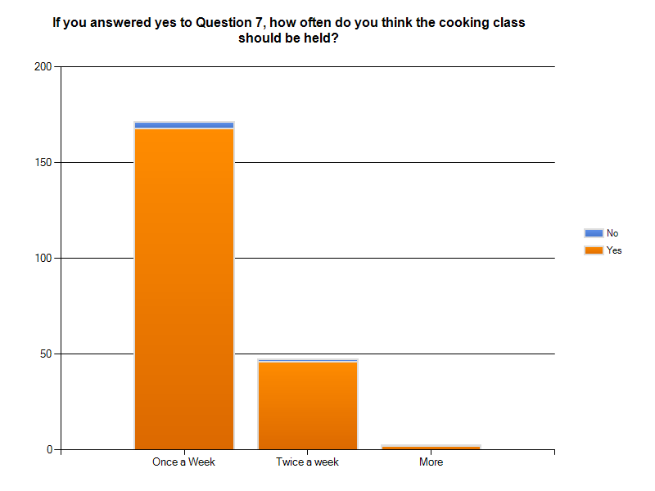
Frequency

Slide 14
When

Slide 15
Time Recommendation
IAP:
8 sessions over 4 weeks
2 hours/session
Semester
once a week, 6 weeks, 2 hours/session

Slide 16
Considerations
Liability
Permanence
Cost
Size
Accessibility to students

Slide 17
Location Selection
Commercial Kitchens
Maseeh Hall Commercial Kitchen
McCormick Hall Commercial Kitchen
Next House Commercial Kitchen
Simmons Hall Commercial Kitchen
Baker Dining Commercial Kitchen
Dormitory Residence Kitchens
Baker
Bexley
Burton Conner
East Campus
Macgregor
McCormick
Maseeh
New House
Next House
Senior House
Simmons
High Capacity Dormitory Kitchens
McCormick Country Kitchen
Next Country Kitchen
Alternative Locations
Pritchett Dining Kitchen
Coffeehouse Lounge

Slide 18
Liability
Commercial Kitchens
Maseeh Hall Commercial Kitchen
McCormick Hall Commercial Kitchen
Next House Commercial Kitchen
Simmons Hall Commercial Kitchen
Baker Dining Commercial Kitchen
Dormitory Residence Kitchens
Baker
Bexley
Burton Conner
East Campus
Macgregor
McCormick
Maseeh
New House
Next House
Senior House
Simmons
High Capacity Dormitory Kitchens
McCormick Country Kitchen
Next Country Kitchen
Alternative Locations
Pritchett Dining Kitchen
Coffeehouse Lounge

Slide 19
Permanence
Commercial Kitchens
Maseeh Hall Commercial Kitchen
McCormick Hall Commercial Kitchen
Next House Commercial Kitchen
Simmons Hall Commercial Kitchen
Baker Dining Commercial Kitchen
Dormitory Residence Kitchens
Baker
Bexley
Burton Conner
East Campus
Macgregor
McCormick
Maseeh
New House
Next House
Senior House
Simmons
High Capacity Dormitory Kitchens
McCormick Country Kitchen
Next Country Kitchen
Alternative Locations
Pritchett Dining Kitchen
Coffeehouse Lounge

Slide 20
Cost
Commercial Kitchens
Maseeh Hall Commercial Kitchen
McCormick Hall Commercial Kitchen
Next House Commercial Kitchen
Simmons Hall Commercial Kitchen
Baker Dining Commercial Kitchen
Dormitory Residence Kitchens
Baker
Bexley
Burton Conner
East Campus
Macgregor
McCormick
Maseeh
New House
Next House
Senior House
Simmons
High Capacity Dormitory Kitchens
McCormick Country Kitchen
Next Country Kitchen
Alternative Locations
Pritchett Dining Kitchen
Coffeehouse Lounge

Slide 21
Size
Commercial Kitchens
Maseeh Hall Commercial Kitchen
McCormick Hall Commercial Kitchen
Next House Commercial Kitchen
Simmons Hall Commercial Kitchen
Baker Dining Commercial Kitchen
Dormitory Residence Kitchens
Baker
Bexley
Burton Conner
East Campus
Macgregor
McCormick
Maseeh
New House
Next House
Senior House
Simmons
High Capacity Dormitory Kitchens
McCormick Country Kitchen
Next Country Kitchen
Alternative Locations
Pritchett Dining Kitchen
Coffeehouse Lounge

Slide 22
Accessibility to Students
Commercial Kitchens
Maseeh Hall Commercial Kitchen
McCormick Hall Commercial Kitchen
Next House Commercial Kitchen
Simmons Hall Commercial Kitchen
Baker Dining Commercial Kitchen
Dormitory Residence Kitchens
Baker
Bexley
Burton Conner
East Campus
Macgregor
McCormick
Maseeh
New House
Next House
Senior House
Simmons
High Capacity Dormitory Kitchens
McCormick Country Kitchen
Next Country Kitchen
Alternative Locations
Pritchett Dining Kitchen
Coffeehouse Lounge

Slide 23
Location Recommendation
Next House Country Kitchen

Slide 24
PE Requirements
Requires min 30 minutes active recreation
Hard to fit in in most classes
Would not work elegantly

Slide 25
Cost of Recommendation Factors
Facility
Equipment
Materials
Instruction
Frequency

Slide 26
Equipment
Pots/pans
Cutlery
Kitchen tools
Flatware
< $30/student

Slide 27
Materials
Exact food supplies depend on dishes
< $10/meal regardless

Slide 28
Total Cost
Fixed Cost
Equipment | $30
Cost Per Class | $10
Facility | $0
Materials | $10
Instruction | $0
Frequency | x 8 sessions
Total | $110/student

Slide 29
Funding Options
MIT
Division of Student Life
Outside
Food companies
Students

Slide 30
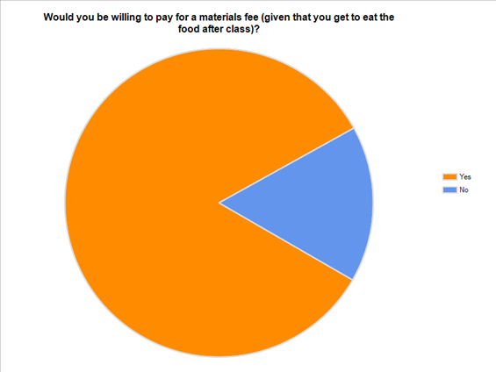
Willingness to Pay

Slide 31
Funding Recommendation
Students pay (and get to keep the equipment and food)

Slide 32
Pilot program feasible with minimal expense
Any questions?

